Slide 1













PLAYING SCREEN ARCHITECTURE = TO BE CAREFULLY FOLLOWED AND STRICTLY RESPECTED PLEASE
Score
+175
Hits
47
Coins
85
3 KEY INDICATORS
(Score / hits / coins)
PROGRESS BAR
(the arrow moves toward the trophies on the right, proportionate to the number of stars collected)
Watch
3 seconds
Freeze 2 icons
BOARD ZONE
With 9 icons
4 MONETIZATION BUTTONS
(the 4 texts should be transformed and replaced by self-explanatory icons)
Cancel board move
Reshuffle the
board or challenge
TIMER
(plain orange is decreasing towards left when seconds remaining decrease)
Challenge 4/10
MAIN MENU BUTTON
Designed as a baker mascot
(main menu should be written on hat)
CHALLENGE & COMMUNICATION ZONE
With challenge numbering and various messages

Slide 2

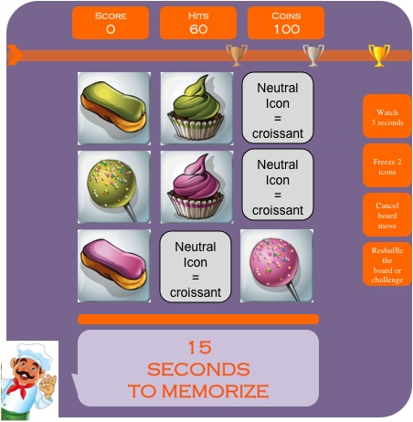
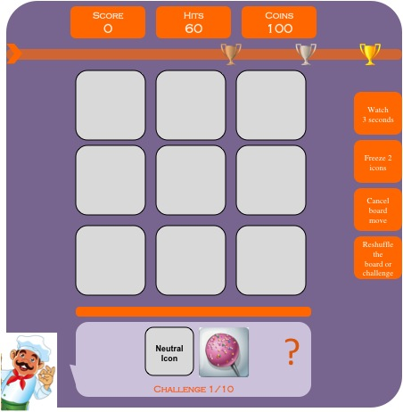
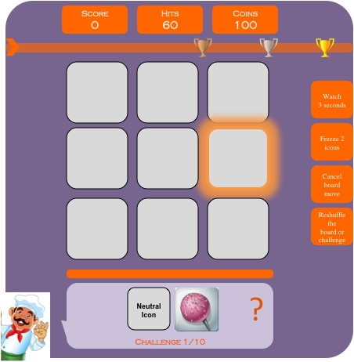
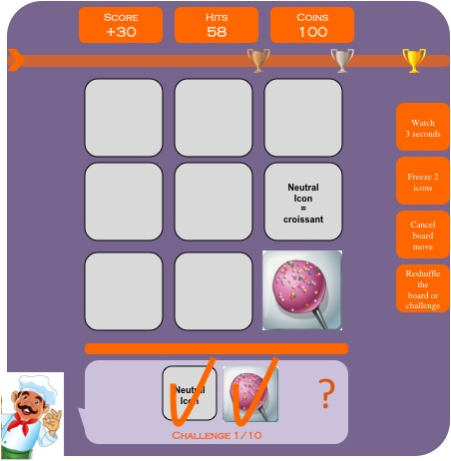
VERY FIRST TIME A PLAYER LOG INTO THE GAME = LEVEL 1 AND TUTORIAL
1/ The logo appears while the game is loading
2/ The title of the game “POPCAKE LEGEND” appears with the baker + background
3/ The player DIRECTLY jump into Level 1 of the game. The orange TIMER line starts decreasing from 15 to 0.
4/ The 9 icons are flipped back and the “Challenge 1/10” appears with a “?” in the CHALLENGE ZONE.
5/ As a TUTORIAL mode, 1 good icon of the challenge is flashing in orange to incentive the player to click on it. The player is not forced to click on the help-icon and can complete the challenge without help if he wants
6/ The score increases and the number of hits decreases until the player completes the challenge

Slide 3
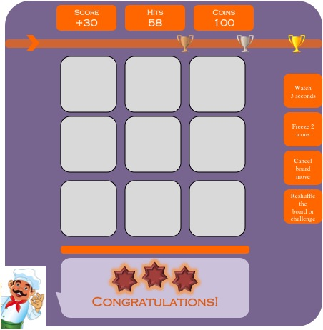
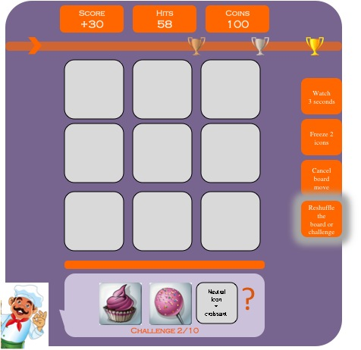
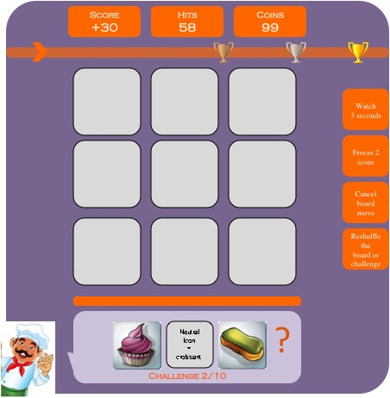
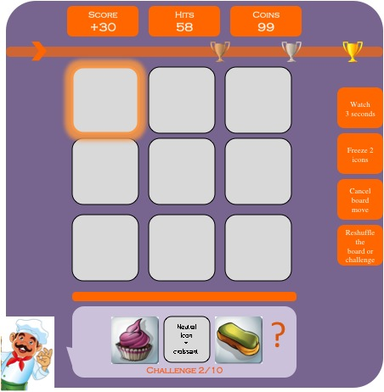
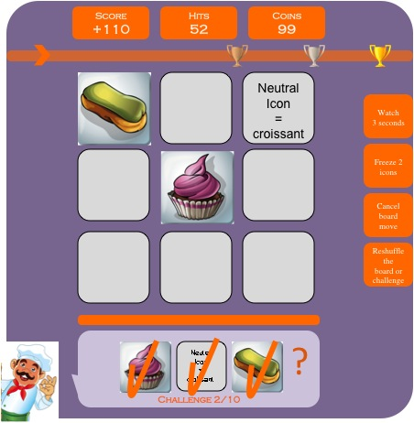
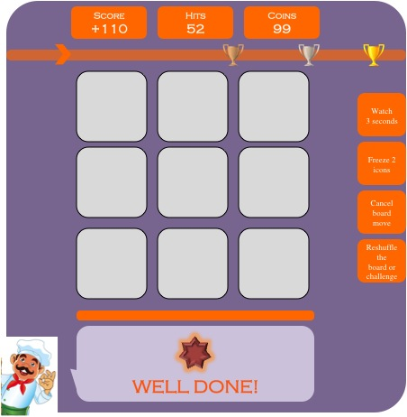
VERY FIRST TIME A PLAYER LOG INTO THE GAME = LEVEL 1 AND TUTORIAL
7/ When the challenge is completed, an encouraging message + chocolate stars (0-3 depending on nb of errors) appear in the COMMUNICATION ZONE. The arrow on the PROGRESS BAR moves accordingly
8/ The Challenge 2/10 appears in the CHALLENGE ZONE. As a TUTORIAL, the RESHUFFLE ICON down-right is highlighted/flashing to incentive the player to click on it.
9/ When the player click on “reshuffle” a new challenge is generated in the CHALLENGE ZONE and the COINS counter is decreased from 100 to 99 (i.e. costs 1)
10/ As a TUTORIAL and HELP mode, 1 good icon of the challenge is highlighted/flashing in orange to incentive the player to click on it. NB: the player is not forced to click on the help-icon and can complete the challenge without help if he chooses to do so
11/ The score increases (REFER TO EXCEL, exponential scoring system) and the number of hits decreases until the player completes the challenge
12/ When the challenge is completed, an encouraging message + chocolate stars (0-3 depending on nb of errors) appear in the COMMUNICATION ZONE. The arrow on the PROGRESS BAR moves accordingly

Slide 4
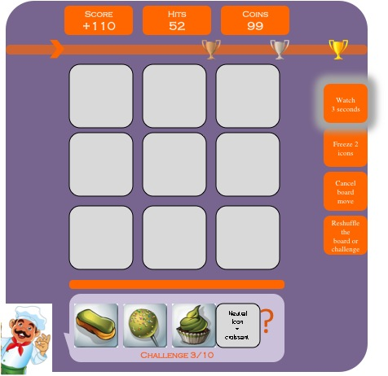
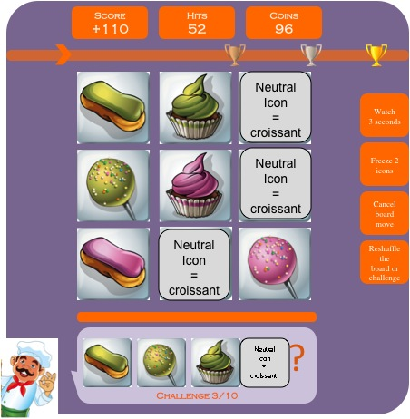
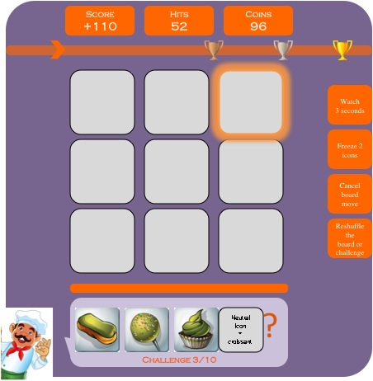
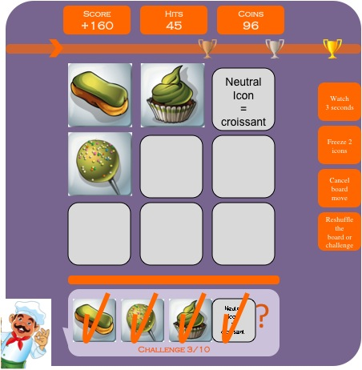
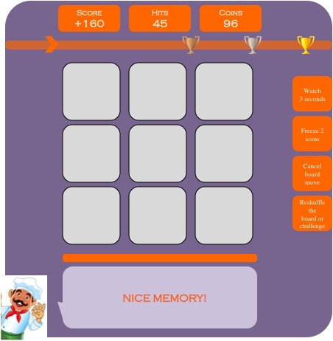
VERY FIRST TIME A PLAYER LOG INTO THE GAME = LEVEL 1 AND TUTORIAL
13/ The Challenge 3/10 appears in the CHALLENGE ZONE. As a TUTORIAL, the WATCH 3 SECONDS icon up-right is highlighted/flashing to incentive the player to click on it.
14/ When the player click on WATCH 3 SECONDS the 9 icons appear for 3 seconds and the COINS counter is decreased from 99 to 96 (i.e. costs 3)
15/ The board disappears and, as a TUTORIAL, 1 good icon of the challenge is highlighted/flashing to incentive the player to click on it. This is the LAST TIME an icon is shown for HELP in the game
16/ The score increases (REFER TO EXCEL, exponential scoring system) and the number of hits decreases until the player completes the challenge
18/ When the challenge is completed, an encouraging message + chocolate stars (0-3 depending on nb of errors) appear in the COMMUNICATION ZONE. The arrow on the PROGRESS BAR moves accordingly

